Slide 1
AI Fundamentals
Natural Language Processing
Prasanna (Sonny) Tambe, Associate Professor of Operations, Information and Decisions

Slide 2
Text is a Valuable Form of Unstructured Data
Can provide valuable “signals” about markets and business decisions
Online reviews tell us a lot about product decisions
Online chatter can tell us about financial market activity

Slide 3
Natural Language Processing
Text can be used to make predictions, but we first have to convert text to “features”
Sentiment, spelling, number of words used, etc.
We can pre-process text to prepare it for analysis
Correct issues with white space, extra spaces, punctuation, etc.
Then identify what it is about the text that might be important for making predictions in the future

Slide 4
Text Features
Example: A word
Which words that appear in different texts predict outcomes
Example: Online review
Look at particular words that have meaning for making predictions about product sales, repeat purchases, whether or not a review is “helpful”
Could be sentimental words, positive/negative words, words about the product

Slide 5
Text Features
Can use combinations of words or groups of words
Sentiment analysis
Describing whether the words someone uses in a piece of text means they are feeling more positive or negative about what they are talking about
Other ways to map sentiment in a way that can map to larger sets of emotions, not just positive or negative

Slide 6
Natural Language Processing
These features extracted from the text allow us to predict outcomes (e.g. sentiment predicts buying behavior)
Deep learning gives us even more flexibility
Can combine the text content in richer and more meaningful ways

Slide 7
Natural Language Processing
Example: News articles and stock price movements
Creating an algorithm that starts with breaking news and generates information or predictions about stock price
Start with a database of news articles
Generate features from the news articles
Label to be predicted may be the stock movement for a given time unit
Use training data to train the model
Test performance on test data set
Deploy

Slide 8
Natural Language Processing
Another common application for NLP, instead of prediction, is taking text and putting it into groups or topics
An example of unsupervised learning
Topic modeling
Classifies documents by content in a way that makes them easier to interpret
Will tell you how these documents should be grouped together in a way that makes it easier to take action on them from a business perspective

Slide 9
AI Fundamentals
GANs and VAEs
Prasanna (Sonny) Tambe, Associate Professor of Operations, Information and Decisions

Slide 10
Generative Models
Instead of classifying data into two categories, a generative model asks what the underlying process is that could have generated the type of data that we are seeing in the sample
Generative models can create new data instances

Slide 11
Generative Models
Many examples of generative models applied to art and music
Generate new songs in particular styles, like country or jazz
Produce art in styles that mimic those of traditional masters (e.g. GANGogh)
Text applications (e.g. GPT-3)
Generate text in a way that could have been written by a student or journalist

Slide 12
Generative Adversarial Networks (GANs)
Used to generate artificial content that is increasingly hard to tell apart from real content
Uses two networks “competing” with one another
A generative network that produces new content
Another network, a discriminator, is used simply to tell whether the output of the first network is real or fake

Slide 13
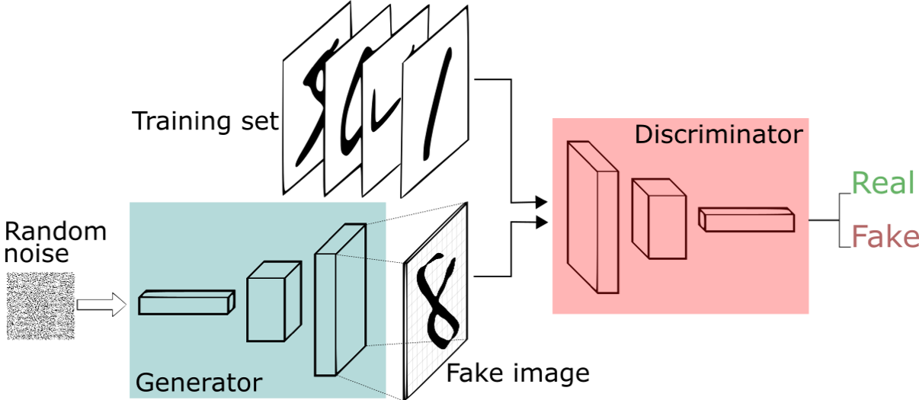
Generator and Discriminator Networks
Over time, the generator will learn what it needs to do to create content that is harder and harder for the discriminator to identify as being fake content

Slide 14
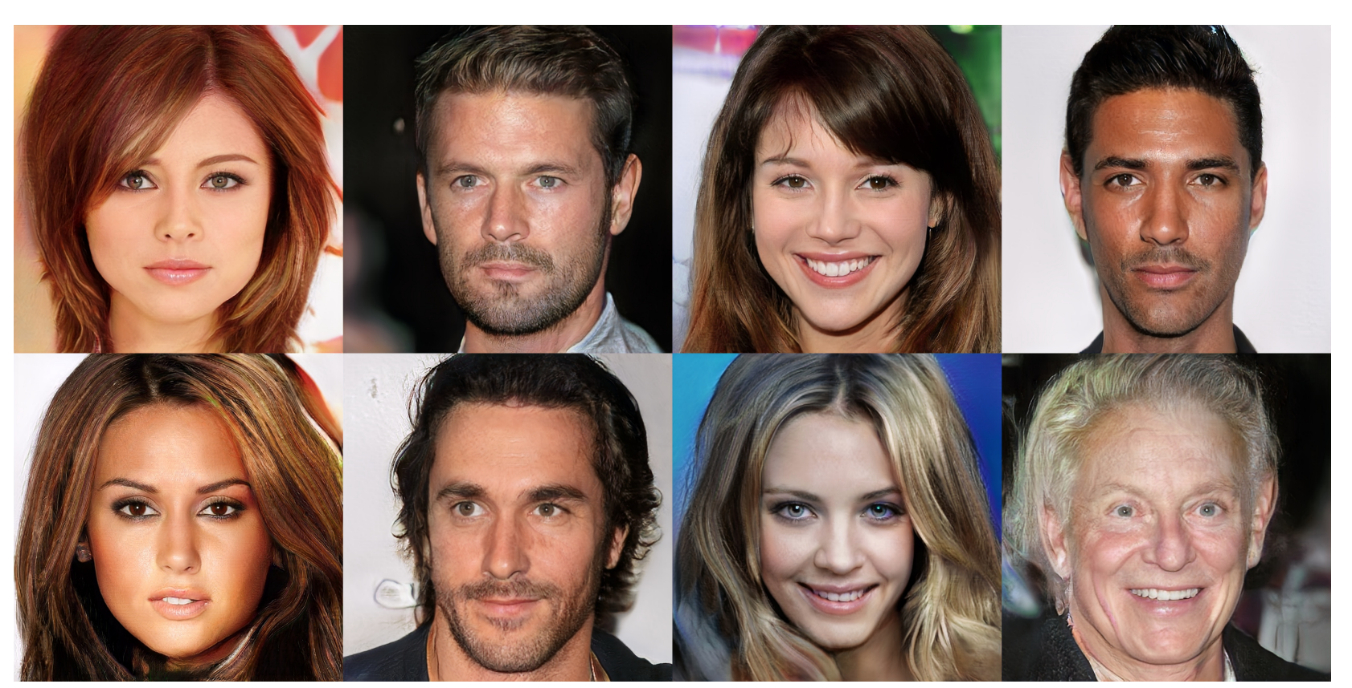
GAN Example: Real vs. Fake Faces

Slide 15
Generative Adversarial Networks (GANs)
A lot of controversy around these types of applications
Concerns around deepfakes

Slide 16
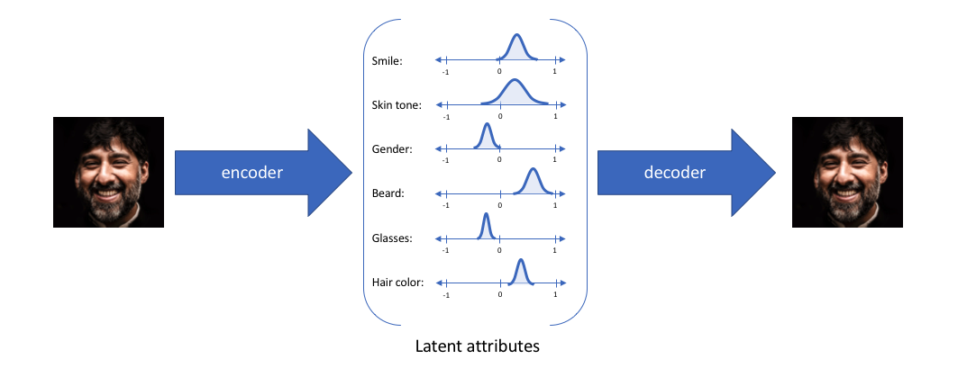
Variational AutoEncoders (VAEs)
Encoders take data and boil it down to a simpler representation
AutoEncoders can take data and boil it down to a simpler representation which can then be used to recreate itself

Slide 17
Variational AutoEncoders (VAEs)
Variational AutoEncoders can be used to slightly vary some attributes or aspects of the image in ways that we might care about
Controlled content generation
Generating artificial content in a way that we can start to control how it’s different or how it gets tweaked

Slide 18
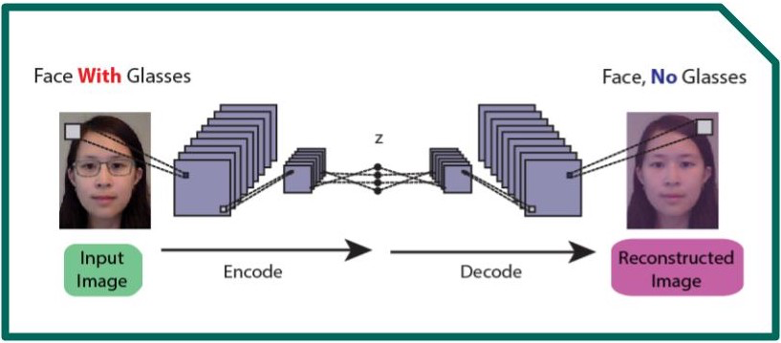
Applications: Controlled Content Generation

Slide 19
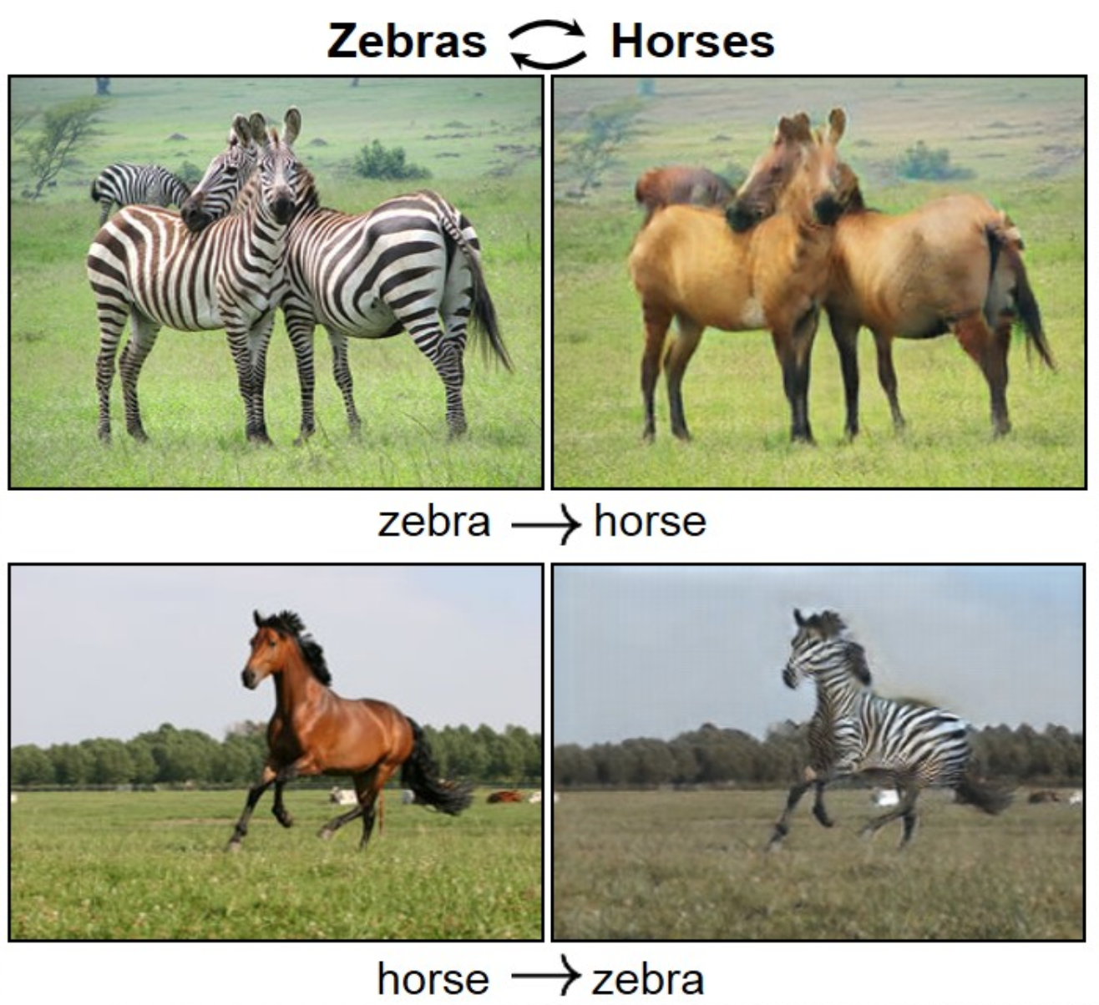

Applications: Controlled Content Generation

Slide 20
AI Fundamentals for Non-Data Scientists
ML Operations
Kartik Hosanagar, Professor of Operations, Information and Decisions

Slide 21
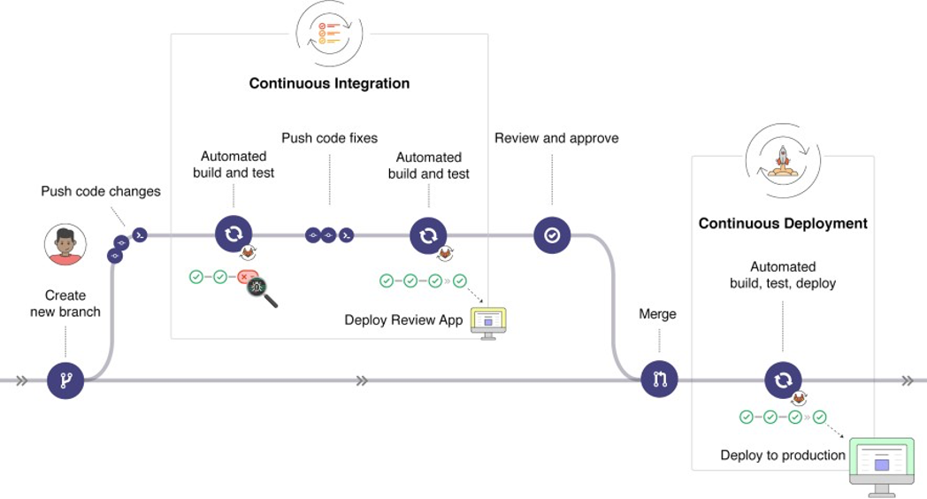
Traditional Dev Ops
Practices and tools used to build, test, and deploy code to production
https://docs.gitlab.com/ee/ci/introduction/

Slide 22
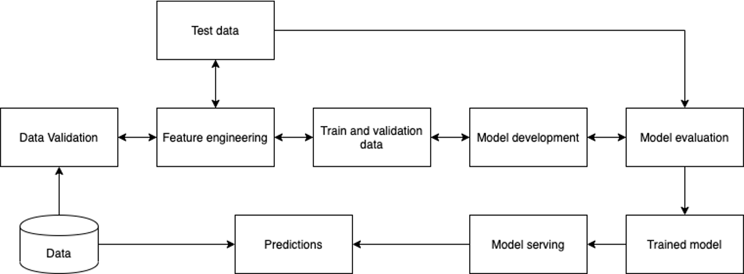
Machine Learning Workflow

Slide 23
Machine Learning Workflow
Code is not the only source of changes, the data might change, the model itself might change as it re-trains

Slide 24
Machine Learning Workflow
Code is not the only source of changes, the data might change, the model itself might change as it re-trains

Slide 25

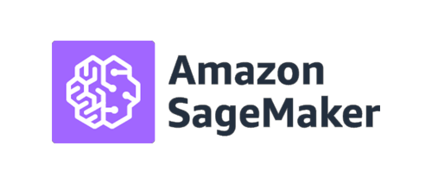
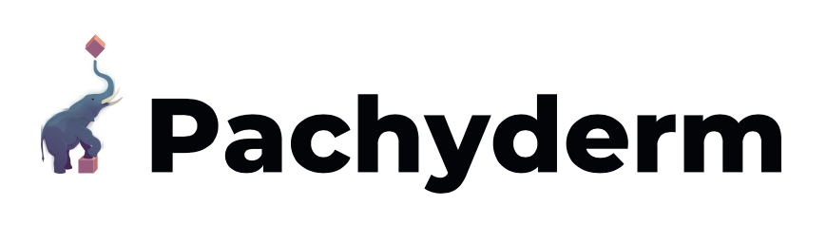
Existing ML Ops Tools
Infrastructure
Management
Data
Management
Model
Management
Deployment
Monitoring

Slide 26
AI Fundamentals for Non-Data Scientists
Chicken and Egg
Kartik Hosanagar, Professor of Operations, Information and Decisions

Slide 27
The Need for Data Can Pose a Chicken & Egg Problem
Performance differences between ML algorithms can be relatively small
Existing companies generally don’t have a problem with obtaining training data
New products can face a chicken and egg problem
Without users, they don’t have data
Without data, they cannot build their AI product
Product(s)
AI Systems
Users
Data

Slide 28
Solving the Chicken & Egg Problem in AI Entrepreneurship
1
Start with a non-AI product that generates data
Original
Product(s)
2
Partner with an organization that has data
AI Systems
Users
3
Crowdsource the (labeled) data you need
New AI Product(s)
Data
4
Make use of public data
5
New
Users
Rethink the need for data

Slide 29
Solving the Chicken & Egg Problem in AI Entrepreneurship
1
Start with a non-AI product that generates data
Original
Product(s)
2
Partner with an organization that has data
AI Systems
Users
3
Crowdsource the (labeled) data you need
New AI Product(s)
Data
4
Make use of public data
5
New
Users
Rethink the need for data

Slide 30

1. Start with a Non-AI Product that Generates Data
Create a non-AI service that solves customer problems, generates the data in the process
That data can then be used to train an AI system that enhances the existing service or creates a related service
Facebook initially didn’t use AI, but the social networking platform generated a lot of data
This data was then used to train AI systems that helped personalize the newsfeed and made it possible to run targeted advertising
https://www.lemonade.com/blog/the-sixth-sense/
https://www.sec.gov/Archives/edgar/data/1691421/000104746920003846/a2241899zs-1a.htm

Slide 31

1. Start with a Non-AI Product that Generates Data
Create a non-AI service that solves customer problems and generates data in the process
This data can then be used to train an AI system that enhances the existing service or creates a related service
InsurTech startup Lemonade didn’t have data to build AI at first, but over time has built AI to create quotes, process claims & detect fraud
Now AI handles the “first notice of loss” for 96% of claims & manages full claim resolution without human involvement in 1/3 of cases
https://www.lemonade.com/blog/the-sixth-sense/
https://www.sec.gov/Archives/edgar/data/1691421/000104746920003846/a2241899zs-1a.htm

Slide 32
Solving the Chicken & Egg Problem in AI Entrepreneurship
1
Start with a non-AI product that generates data
Original
Product(s)
2
Partner with an organization that has data
AI Systems
Users
3
Crowdsource the (labeled) data you need
New AI Product(s)
Data
4
Make use of public data
5
New
Users
Rethink the need for data

Slide 33


2. Partner With An Organization That Has Data
Partner with a company/organization that has proprietary data but lacks AI expertise
This is particularly useful if it is difficult to create a product that generates the kind of data you need (e.g. medical data)
+
Combine patient data with Google’s cloud and AI capabilities to solve important questions in healthcare
Using alarm data to distinguish “false alarms from real ones” in hospitalized patients’ monitors.
https://med.stanford.edu/news/all-news/2016/08/stanford-medicine-google-team-up-to-harness-power-of-data-science.html

Slide 34
Solving the Chicken & Egg Problem in AI Entrepreneurship
1
Start with a non-AI product that generates data
Original
Product(s)
2
Partner with an organization that has data
AI Systems
Users
3
Crowdsource the (labeled) data you need
New AI Product(s)
Data
4
Make use of public data
5
New
Users
Rethink the need for data

Slide 35
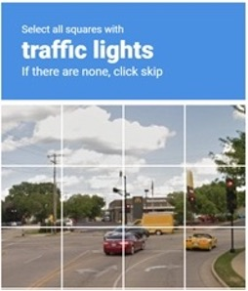
3. Crowdsource the (Labeled) Data You Need
Crowdsourcing platforms like Amazon’s Mechanical Turk or Scale AI can be used to get label data
CAPTCHAs
While CAPTCHAs serve an important security purpose, Google simultaneously uses them as a crowdsourced image labeling system
Workflow that works to label data without being distracting to the user
https://medium.com/swlh/ai-labeling-crowdsourcing-platforms-630adbc79c40
CAPTCHA Image: https://chrome.google.com/webstore/detail/buster-captcha-solver-for/mpbjkejclgfgadiemmefgebjfooflfhl

Slide 36
Solving the Chicken & Egg Problem in AI Entrepreneurship
1
Start with a non-AI product that generates data
Original
Product(s)
2
Partner with an organization that has data
AI Systems
Users
3
Crowdsource the (labeled) data you need
New AI Product(s)
Data
4
Make use of public data
5
New
Users
Rethink the need for data

Slide 37
4. Make Use of Public Data (and Pre-Trained Models)
Products based on public data may be less defensible, but defensibility can be built via other product innovations
Can also use publicly available pre-trained ML models that can be customized with transfer learning
Before you conclude that the data you need is not available, look harder— there is more publicly available data than you might imagine, including data marketplaces
https://www.cnbc.com/2020/03/03/bluedot-used-artificial-intelligence-to-predict-coronavirus-spread.html

Slide 38
Solving the Chicken & Egg Problem in AI Entrepreneurship
1
Start with a non-AI product that generates data
Original
Product(s)
2
Partner with an organization that has data
AI Systems
Users
3
Crowdsource the (labeled) data you need
New AI Product(s)
Data
4
Make use of public data
5
New
Users
Rethink the need for data

Slide 39
5. Rethink the Need for Data
Most of the practical AI today is built on ML (particularly supervised ML, which requires large labeled training datasets)
There are many approaches to building AI without large datasets
Reinforcement learning
Expert systems
https://medium.com/curai-tech/the-science-of-assisting-medical-diagnosis-from-expert-systems-to-machine-learned-models-cc2ef0b03098

Slide 40
Reinforcement Learning
AI systems do not begin with large training datasets, but learn by taking actions and observing the results
Google’s AlphaGo was trained on a large dataset, but iteration #2, AlphaZero, was based on reinforcement learning— yet AlphaZero beat AlphaGo (which itself beat world champion Lee Sedol)

Slide 41
Expert Systems
Simple rule-based systems that codify rules used by experts
These rarely beat well-trained ML for complex tasks, but they can help you get started

Slide 42


